Slide 1
GOES-18 GLM Full Validation
Peer/Stakeholder Product Validation Review (PS-PVR)
Nov. 8, 2023
NWS Perspective: AWIPS Verification and Forecaster Feedback
John D. Evans, GST, Inc. / TOWR-S team, NWS Office of Observations
with indispensable contributions from
Lee Byerle, KBR, Inc. / TOWR-S Team, GOES-R Program Office

Slide 2
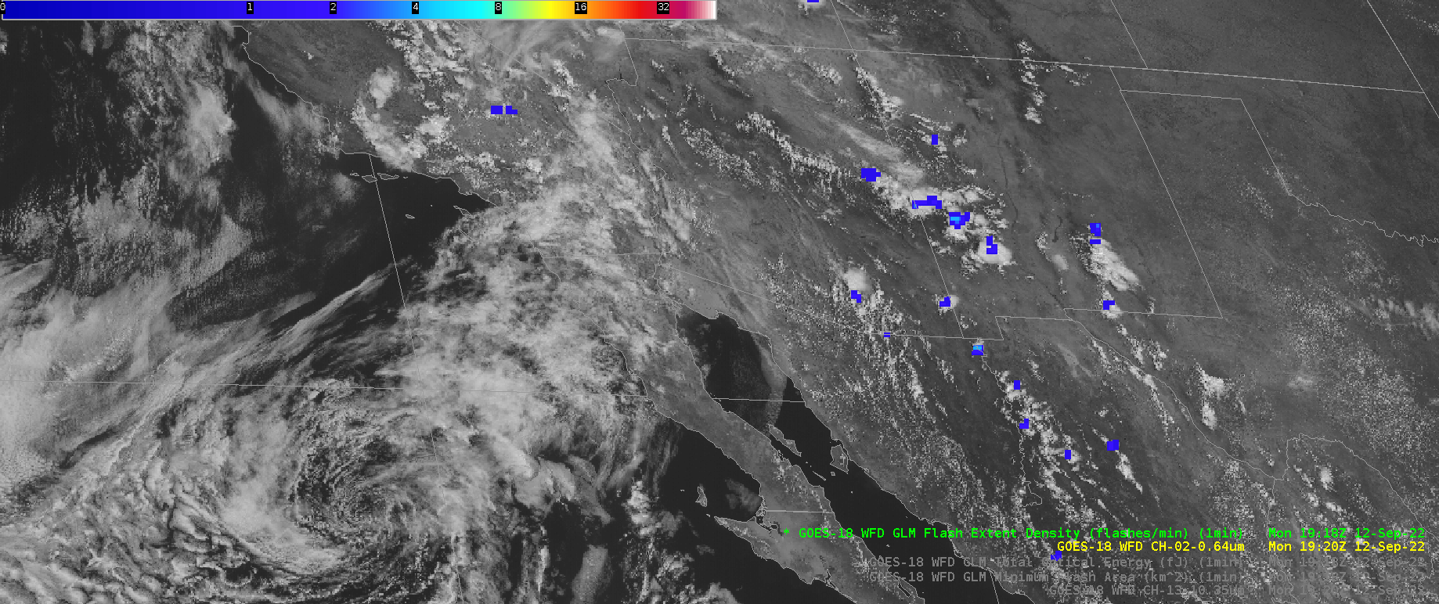
GOES-18 Gridded GLM Products in AWIPS: Flash Extent Density

Slide 3
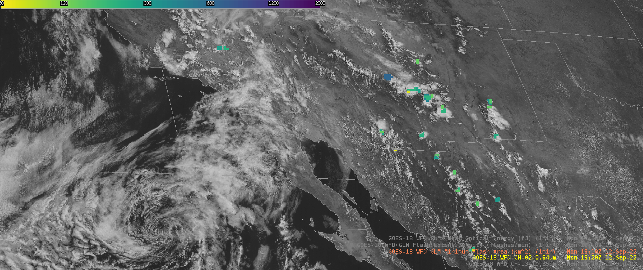
GOES-18 Gridded GLM Products in AWIPS: Minimum Flash Area

Slide 4
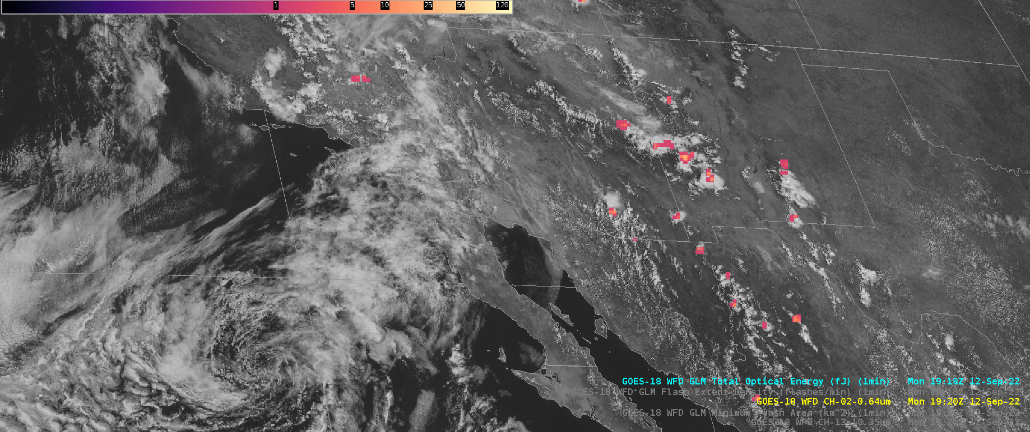
GOES-18 Gridded GLM Products in AWIPS: Total Optical Energy

Slide 5
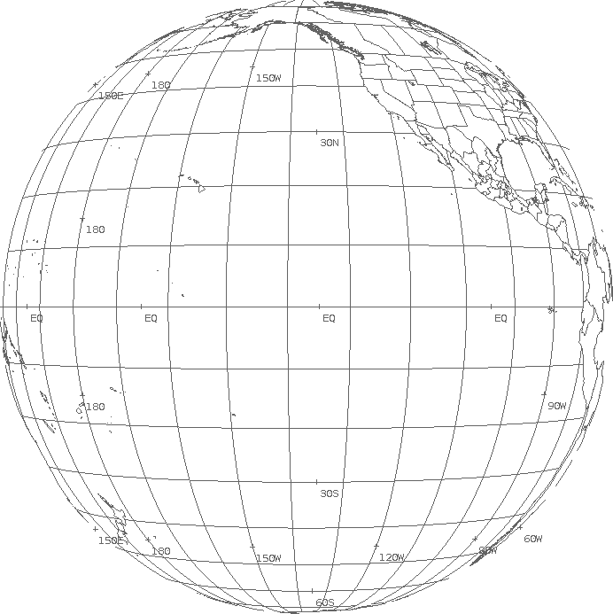
Notes on AWIPS integration of Gridded GLM Data Products
Gridded GLM (1-minute) has been operationally available to AWIPS since Mar. 6, 2023.
But many AWIPS sites had been receiving the pre-operational version of it since July 2018.
AWIPS' Network Control Facility (NCF) is configured to
Apply WMO headers "TIRS00 KNES" (East) or "TIRT00 KNES" (West) to gridded GLM files arriving from the GOES-R GS;
Translate tile numbers (000, 001, … 061) to WMO Bulletin Segment Headers (PAA, PAB, … PCJ) and apply them;
Distinguish GLMFDSTAT summary files from GLM data tiles and give them special "PZZ" Segment Headers;
The new AWIPS Pre-Processor ["APP"] uses the GLMFDSTAT files to construct 5-minute aggregations of FED, MFA, TOE
Route the tiles / files to the Satellite Broadcast Network (SBN) Channels GRE (East) or GRW (West).
 | 000 PAA | 001 PAB | 002 PAC | 003 PAD
004 PAE | 005 PAF | 006 PAG | 007 PAH | 008 PAI | 009 PAJ
010 PAK | 011 PAL | 012 PAM | 013 PAN | 014 PAO | 015 PAP
016 PAQ | 017 PAR | 018 PAS | 019 PAT | 020 PAU | 021 PAV
022 PAW | 023 PAX | 024 PAY | 025 PAZ | 026 PBA | 027 PBB
028 PBC | 029 PBD | 030 PBE | 031 PBF | 032 PBG | 033 PBH
034 PBI | 035 PBJ | 036 PBK | 037 PBL | 038 PBM | 039 PBN
040 PBO | 041 PBP | 042 PBQ | 043 PBR | 044 PBS | 045 PBT
046 PBU | 047 PBV | 048 PBW | 049 PBX | 050 PBY | 051 PBZ
052 PCA | 053 PCB | 054 PCC | 055 PCD | 056 PCE | 057 PCF
 | 058 PCG | 059 PCH | 060 PCI | 061 PCJ
GOES-West Gridded GLM tiles

Slide 6
Notes on AWIPS integration of Gridded GLM Data Products
AWIPS site configurations for this gridded GLM product were part of TOWR-S RPM v23 (Feb. 2023):
New filename pattern in the “dataset_name” global attribute
Special handling of GLMFDSTAT files
Otherwise handled just like GOES-R SCMI imagery tiles
"Punctured tile" scheme trims file counts & data volumes on the SBN
GOES-West: ~12,000 files/day, ~1.2 GB/day
GOES-East: ~25,000 files/day, ~2.0 GB/day
Public Service Change Notice, and Dataset Guide on VLab, detail gridded GLM data content, tiling, size, cadence, WMO headers, and links to documentation, Training Resources, Quick Guides, etc.

Slide 7
Forecaster Use of Gridded GLM data products
See NWS input to GOES-16 GLM PS-PVR (Nov. 2018), “GOES-16 GLM Implementation in NWS”
Applications; User comments; Implementation phases
See NWS update to GOES-17 GLM PS-PVR (Feb. 2021), “GOES-17 GLM in AWIPS”
See K. Thiel, “GLM in the 2022 HWT Satellite Proving Ground Experiment”
Role in Decision support; Importance of FED, MFA; Uses of East+West GLM
Many NWS forecasters have now had 3+ years of experience with gridded GLM data products
Frequent topic in the weekly Satellite Book Club seminar - for example:
Session 4 (What is better than one GL mapper?) Session 5 (May 7, 2020 severe outbreak) Session 9 (Florida Keys tracking updraft strength, special role for airport warnings) Session 16 (Great Lakes "marginally severe" events) Session 22 (Understanding GLM) Session 26 (Application of GLM during a severe weather outbreak in Oklahoma) Session 40 (Communicating TC Hazards) | Session 41 (Tornado detection Mid-Atlantic) Session 68 (LightningCast intro from CIMSS) Session 70 (Radar down, Severe Risk up) - "Lightning and sat trends are your friend" Session 110 (EF 2 tornado Midland WFO) Session 119 (GLM for tornado warnings during landfalling tropical cyclones) Session 168 (Using GLM to Predict Tornadogenesis during a Quasi-Linear Convective System)

